Slide 1
Unreliable UDP Communication
Session 05
Course : COMP6584001 – Network and Systems Programming
Ivan Sebastian Edbert

Slide 2
Learning Objectives
At the end of this session, the student will be expected to :
Understand the concept of sending and receiving UDP Data
Able to avoid fragmentation

Slide 3
Outline
Using UDP
Sending and Receiving UDP Data
Avoiding Fragmentation

Slide 4
Using UDP: Simple and reliable

Slide 5
User Datagram protocol (UDP)
Definition
The User Datagram Protocol, or UDP, is a communication protocol used across the Internet for especially time-sensitive transmissions such as video playback or DNS lookups.
It speeds up communications by not formally establishing a connection before data is transferred. This allows data to be transferred very quickly, but it can also cause packets to become lost in transit — and create opportunities for exploitation in the form of DDoS attacks.
How does UDP Work?
UDP is a standardized method for transferring data between two computers in a network.
Compared to other protocols, UDP accomplishes this process in a simple fashion: it sends packets (units of data transmission) directly to a target computer, without establishing a connection first, indicating the order of said packets, or checking whether they arrived as intended. (UDP packets are referred to as ‘datagrams’.)

Slide 6
Sending and Receiving UDP Data

Slide 7
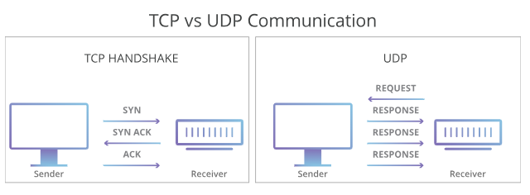
TCP Vs UDP
UDP is faster but less reliable than TCP, another common transport protocol. In a TCP communication, the two computers begin by establishing a connection via an automated process called a ‘handshake.’ Only once this handshake has been completed will one computer actually transfer data packets to the other.
UDP communications do not go through this process. Instead, one computer can simply begin sending data to the other:
In addition, TCP communications indicate the order in which data packets should be received and confirm that packets arrive as intended. If a packet does not arrive — e.g. due to congestion in intermediary networks — TCP requires that it be re-sent. UDP communications do not include any of this functionality.

Slide 8
TCP Vs UDP
These differences create some advantages. Because UDP does not require a ‘handshake’ or check whether data arrives properly, it is able to transfer data much faster than TCP.
However, this speed creates tradeoffs. If a UDP datagram is lost in transit, it will not be re-sent. As a result, applications that use UDP must be able to tolerate errors, loss, and duplication.
(Technically, such packet loss is less a flaw in UDP than a consequence of how the Internet is built. Most network routers do not perform packet ordering and arrival confirmation by design, because doing so would require an unfeasible amount of additional memory. TCP is a way of filling this gap when an application requires it.)

Slide 9
User datagram Protocol (UDP)
Function
UDP is commonly used in time-sensitive communications where occasionally dropping packets is better than waiting. Voice and video traffic are often sent using this protocol because they are both time-sensitive and designed to handle some level of loss. For example, VoIP (voice over IP), which is used by many Internet-based telephone services, typically operates over UDP. This is because a static-y phone conversation is preferable to one that is crystal clear but heavily delayed.
This also makes UDP the ideal protocol for online gaming. Similarly, because DNS servers both need to be fast and efficient, they operate through UDP as well.

Slide 10
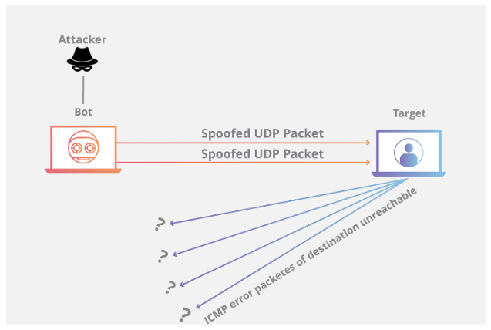
User datagram Protocol (UDP)
How is UDP used in DDoS attacks?
UDP ‘risks’ like packet loss are not a serious problem in most use cases. However, UDP can be exploited for malicious purposes. Since UDP does not require a handshake, attackers can ‘flood’ a targeted server with UDP traffic without first getting that server’s permission to begin communication.
A typical UDP flood attack sends a large number of UDP datagrams to random ports on its target computer. This forces the target to respond with an equally large number of ICMP packets, which indicate those ports were unreachable. The computing resources required to respond to each fraudulent datagram can exhaust the target, resulting in a denial-of-service to legitimate traffic. (To learn more, read our article on UDP flood attacks.)
Organizations can defend against UDP flood attacks with a variety of methods. One is to limit the response rate of ICMP packets, though this approach can also filter out legitimate packets. Another method is to receive and respond to UDP traffic through an intermediary network of many distributed data centers, preventing a single origin server from being overwhelmed with fraudulent requests

Slide 11
User datagram Protocol (UDP)
Important about UDP
UDP communication is connectionless, so there is no need to establish a connection before sending data.
Each UDP datagram is handled independently.
Error handling is crucial, especially when dealing with network operations.
UDP does not guarantee the delivery of messages, so applications need to handle potential packet loss or duplication themselves.

Slide 12
Avoiding Fragmentation

Slide 13
Avoiding fragmentation
Avoiding fragmentation in network communication is important for efficient data transmission. Fragmentation occurs when a data packet is too large to fit into the Maximum Transmission Unit (MTU) of a network, and it needs to be divided into smaller fragments. While some level of fragmentation is a normal part of network communication, minimizing it can help improve performance and reduce the likelihood of issues.
Here are some strategies to avoid fragmentation:
MTU Discovery:
Use Path MTU Discovery (PMTUD) to dynamically discover the smallest MTU along the path between two communicating hosts. PMTUD allows hosts to adjust the size of their packets to avoid fragmentation in the network.
Packet Size Consideration:
Design your application protocols and data structures with consideration for the typical MTU of the networks over which your data will be transmitted. Try to keep packet sizes well below the typical MTU to reduce the likelihood of fragmentation.

Slide 14
Avoiding fragmentation
Adjusting Socket Buffer Sizes:
On the sending side, you can adjust the socket buffer size to accommodate larger amounts of data, reducing the need for fragmentation. The net package in Go allows you to set the write buffer size for a TCP or UDP connection.
Packet Size Negotiation:
If your application protocol allows for negotiation between the communicating parties, consider including a negotiation mechanism to agree on an appropriate packet size to avoid fragmentation.
Using a Protocol with Built-in Fragmentation Handling:
Some application layer protocols, such as QUIC, are designed with built-in mechanisms to handle fragmentation efficiently. Consider using protocols that have features to deal with packet size issues.

Slide 15
Avoiding fragmentation
Compression:
Compressing data before transmission can reduce the size of the payload, potentially avoiding fragmentation. However, the benefits of compression depend on the nature of the data being transmitted.
It's essential to note that fragmentation can be unavoidable in some cases, especially when dealing with networks of varying MTU sizes. Additionally, the level of control you have over the network infrastructure and the specific requirements of your application will influence the approach you choose.
Testing and monitoring your application's performance under different network conditions can help you identify and address any fragmentation issues that may arise. Keep in mind that the effectiveness of these strategies may vary based on the specifics of your network environment and use case.

Slide 16
references
Adam Woodbeck - Network Programming with Go_ Learn to Code Secure and Reliable Network Services from Scratch-No Starch Press (2021).
https://www.cloudflare.com/learning/ddos/glossary/user-datagram-protocol-udp/#:~:text=The%20User%20Datagram%20Protocol%2C%20or,connection%20before%20data%20is%20transferred.

Slide 17
Thankyou

